Slide 1
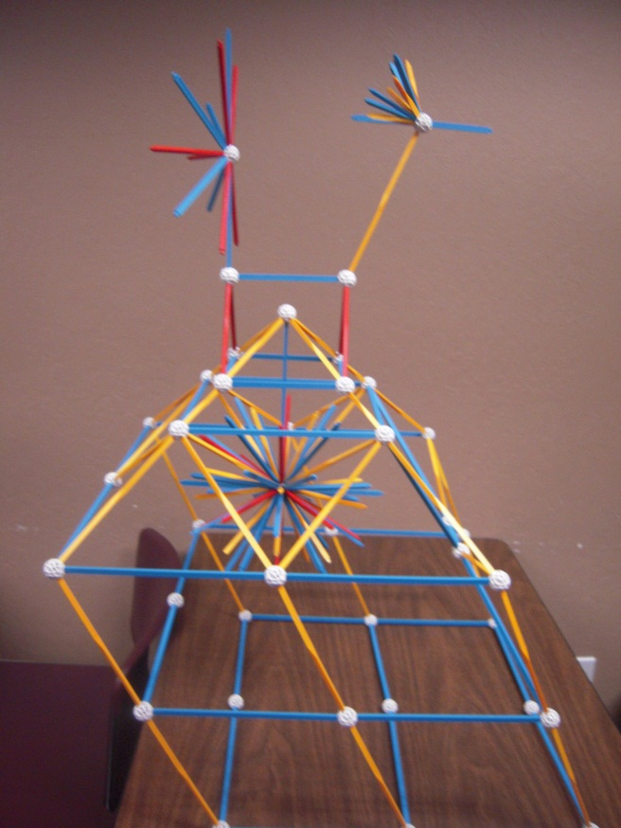
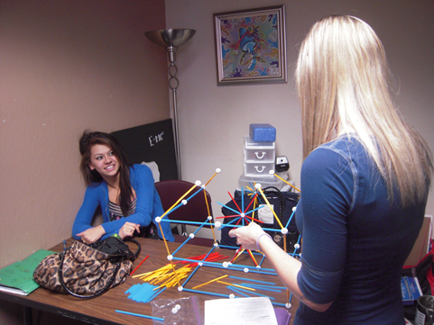
The Leaning Tower Of Trigonometry
By,
Leslie Ryan
&
Jessica Royston

Slide 2
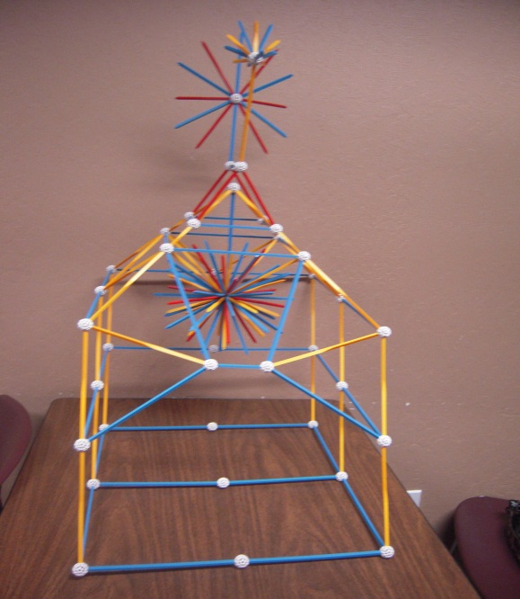
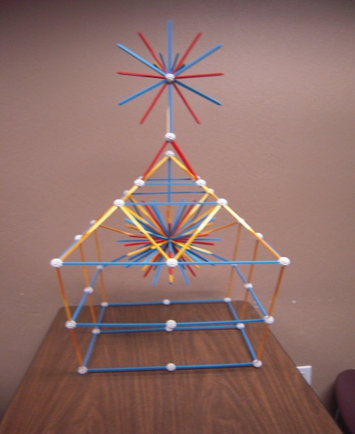
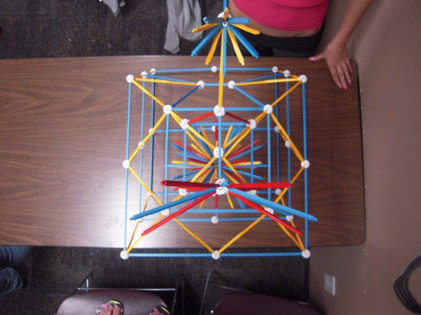
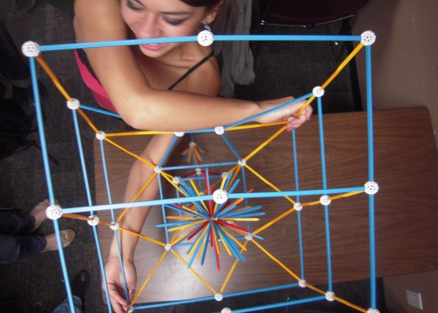
A LOOK AT OUR PROJECT

Slide 3
The Measurements- Leslie’s Triangles
ANGLES SIDES
<A=45° <B=45° <C=90° a=7.5 b=7.5 c=10.5
<A=20° <B=70°<C=90° a=2.5 b=6 c=6
3. <A=90°<B=50°<C=40° a=6.5 b=5.5 c=3.5
<A=40° <B=50°<C=90° a=1.5 b=2 c=2.5
<A=60° <B=30° <C=90° a=2 b=1.5 c=2.5
<A=45°<B=45°<C=90° a=4.5 b=4.5 c=6.5
7. <A=45°<B=45°<C=90° a=5 b=4.5 c=7
8. <A=40°<B=65°<C=80° a=2.5 b=4.5 c=4
9. <A=75°<B=35°<C=90° a=4 b=1 c=4
10. <A=30°<B=60°<C=90° a=2 b=3 c=4

Slide 4
The Measurements- Jessica’s Triangles
ANGLES SIDES
1. <A=90° <B=45° <C=45° a=10.5 b=7.5 c=7.5
2. <A=90° <B=70° <C=20° a=6 b=6 c=2.5
3. <A=40° <B=50° <C=90° a=3.5 b=5.5 c=6.5
4. <A=40° <B=50° <C=90° a=1.5 b=2 c=2.5
5. <A=35° <B=75° <C=90° a=1 b=4 c=4
6. <A=90° <B=45° <C=45° a=7 b=5 c=4.5
7. <A=45° <B=45° <C=90° a=4.5 b=4.5 c=6.5
8. <A=40° <B=65° <C=90° a=4.5 b=4 c=2.5
9. <A=30° <B=60° <C=90° a=2 b=1.5 c=2.5
10. <A=30° <B=60° <C=90° a=2 b=3 c=4

Slide 5
OBTUSE- #2
c
b
ANGLES
SIDES
<A= 20°
<B= 70°
<C= 90°
180°
a= 2.5
b= 6
c= 6
a
a²+b²=c²
2.5²+6²=6²
6.25+36=36
42.25=/=36
OBTUSE
sin 70° - 6/6
.891=/=1
cos 70° - 2.5/6
.453=/=.416
tan 70° - 6/2.5
1.962=/=2.4

Slide 6
OBTUSE- #3
ANGLES
<A= 90°
<B= 50°
<C= 40°
180°
SIDES
a= 3.5
b= 5.5
c= 6.5
c
b
a
a²+b²=c²
3.5²+5.5²=6.5²
12.25+ 30.25= 42.25
42.5=/=42.25
OBTUSE
sin 50°- 5.5/6.5
.707=/=.846
cos 50°- 3.5/6.5
.707=/=.538
tan 50°- 5.5/3.5
1=/=1.571

Slide 7
ACUTE- #6
c
a
ANGLES
<A= 45°
<B= 45°
<C= 90°
180°
SIDES
a= 4.5
b= 4.5
c= 6.5
b
a²+b²=c²
4.5²+4.5²=6.5²
20.25+ 20.25= 42.25
40.5=/=42.25
ACUTE
sin 45°- 4.5/6.5
.649=/=.692
cos 45°- 4.5/6.5
.760=/=.692
tan 45°- 4.5/4.5
.854=/=1

Slide 8
ACUTE- #7
c
b
ANGLES
<A= 45°
<B= 45°
<C= 90°
180°
SIDES
a= 5
b= 4.5
c= 7
a
a²+b²=c²
5²+4.5²=7²
25+ 20.25= 49
45.25=/=49
ACUTE
sin 45°- 4.5/7
.649=/=.642
cos 45°- 5/7
.760=/=.714
tan 45°- 4.5/5
.854=/=.9

Slide 9
b
RIGHT ANGLE- #5
a
c
ANGLES
<A= 60°
<B= 30°
<C= 90°
180°
SIDES
a= 2
b= 1.5
c= 2.5
a²+b²=c²
2²+1.5²=2.5²
4+ 2.25= 6.25
6.25 = 6.25
RIGHT TRIANGLE!
sin 60°- 2/2.5
.809=/=.8
cos 60°- 1.5/2.5
.587=/=.6
tan 60°- 2/1.5
1.376 =/=1.333

Slide 10
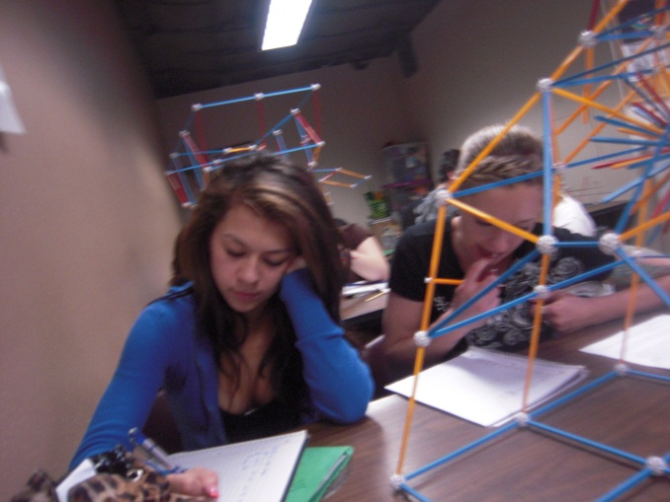
Conclusion
The unique building I made was simple yet complicated. There were tons of different triangles of different sizes. After hours of not so very fun math, I figured out that most the triangles I measured for were everything but right triangles. I think if this building were to be made in real life it would be a cool funky looking building.
ILOVELYDIA!

