Slide 1
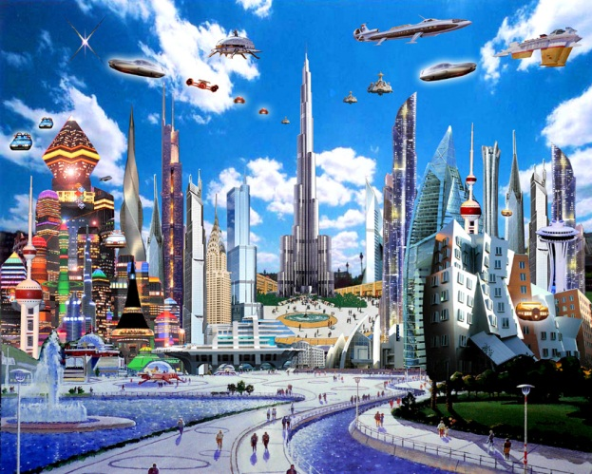
Are You Ready For Some Future!?!
Leslie Ryan
Fall 2010

Slide 2
Contents
Future Technology
The Future In Computers
Future In Art
Smart Clothes
Future Car Technology
Future Architecture

Slide 3
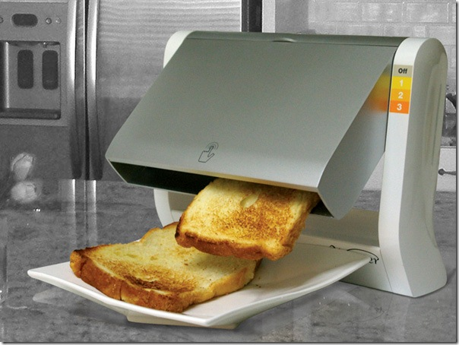
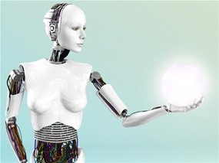
Future Technology
It is hard for anyone to know what the future really holds. Whether something is likely to continue, and what is likely to change. Let’s just say a lot will change when the future comes. Ideas of the future include: Robotics, Human Cloning, Devices to control your emotions, Age Reversal, Smaller more portable Computers, Holographic messages, Clothes that help you health, Computers that predict the future, Weather controls, Ice cream that won’t melt, Pets that live forever, time machines, and so much more. It will be a crazy world ahead of us, but it also might be a lot easier one too for most people.

Slide 4
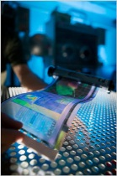
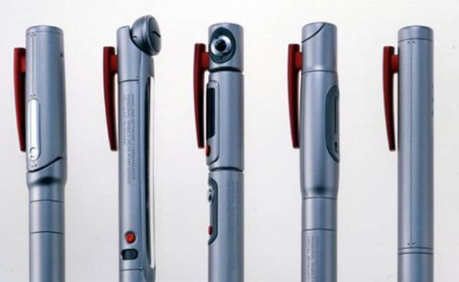
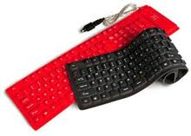
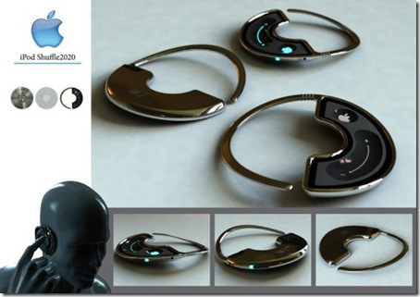
The Future Of Computers
Today's computers operate using transistors, wires and electricity. Future computers will probably use atoms, fibers and light. Some future computers might even be so small you won’t even notice they are there. Computers advance everyday. Soon computers can make other computers. Your own computer can even become your own personal assistant. The computer device would know your personal preferences and be able to make some decisions for you.

Slide 5
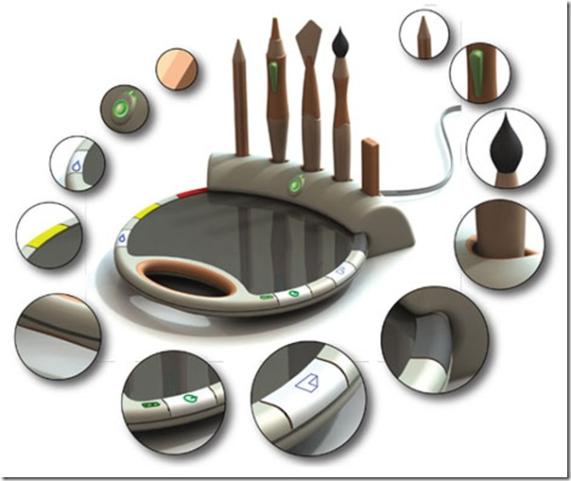
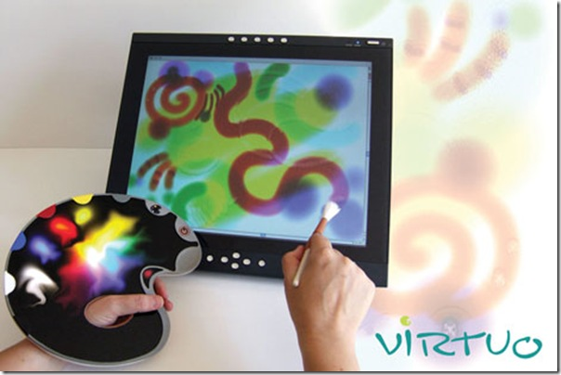
Future Of Art
Usually when we talk about art we think of canvas. In the future we will be saying good bye to canvas masterpieces. Yana Klimava is changing the way we will look at art forever. The new devices name is Virtuo. Virtuo is mainly designed for beginning artists and every day art. This device does not need a battery to operate. It has the latest sensor technology for better interaction with the pen. It can also translate any gesture from the user and make it into a visual creation.

Slide 6
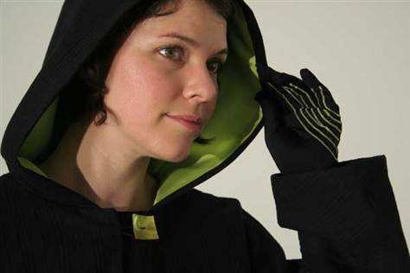
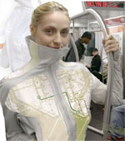
Smart Clothes
Today we see everyday things becoming networked, even your clothes will be before too long. Your clothes will vary from motion detector pants that let a computer know your every move, to a heart sensing bra that keeps track of a persons heart rate and shows it on a watch worn on your wrist. An idea of smart clothes that has already been made are Nike+ running shoes. They have a sensor in them that tracks your run and sends the information to your ipod.

Slide 7
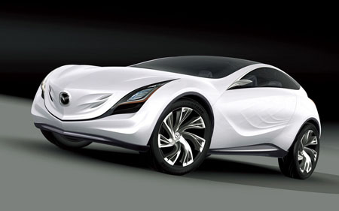
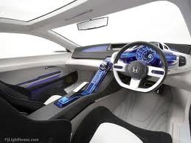
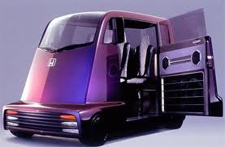
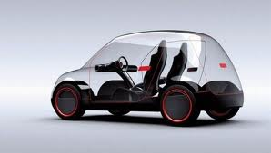
Future Car Technology
The progression of cars is moving so fast they can drive themselves. Literally. Cars of the future have new energy sources and materials that help them become more safer, more sustainable, energy efficient, and less polluting. Some major technologies in cars include:
Emergency Steer Assist ,which lets your car know how much traction it has, and how many feet it's going to take to brake in time to avoid an accident.
AutoLinQ, which reads your e-mail out loud to reduce distraction, it also has Pandora radio and navigation already built in.

Slide 8
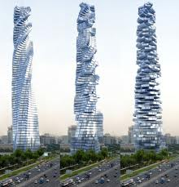
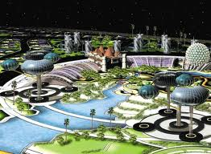
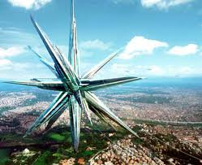
Future Architecture
Have you ever wondered what building of the future are going to look like? I did and that’s the reason I’m telling you about it. A lot of future buildings are built the way they are as a type of art, some to help prevent it from being destroyed by natural disasters. Each model will have a different purpose. Some models are already in the process of being made, while others are just an idea. I think it would be cool to have buildings like this in our world to make the world a more creative and artsy place. It would give the place a more unique, quirky look.

Slide 9
Resource/ Links
Future Technology Links:
http://www.futureforall.org/
http://itechfuture.com/
http://inventors.about.com/od/fstartinventions/tp/Future_Techno.htm
Future In Computers Links:
http://gajitz.com/thin-flexible-leds-might-give-us-roll-up-computer-screens/
http://www.futureforall.org/computers/computers.htm
http://www.historyoftheuniverse.com/futucomp.html
Future In Art Links:
http://itechfuture.com/virtuo-future-digital-art-device/
http://www.tuvie.com/search/concept+art+future+city
http://leifutureculture.blogspot.com/2009/09/state-of-art-technology-for-physically.html
Smart Clothes Links:
http://www.readwriteweb.com/archives/10_smart_clothes_youll_soon_be_wearing.php
http://electronics.howstuffworks.com/gadgets/high-tech-gadgets/computer-clothing.htm
http://www.sciencedaily.com/releases/2008/03/080329121141.htm
http://www.msnbc.msn.com/id/37579367/ns/technology_and_science-innovation/t/smart-clothing-responds-wearers-emotions/
Future Car Technology Links:
http://en.wikipedia.org/wiki/Future_car_technologies
http://auto.howstuffworks.com/under-the-hood/trends-innovations/driverless-car2.htm
http://www.popularmechanics.com/cars/news/industry/5-technologies-coming-to-your-car-soon
Future Architecture Links:
http://s-archetype.blogspot.com/
http://freshome.com/2008/06/11/future-architecture-floating-ecopolis-for-climate-refugees/
http://www.huffingtonpost.com/2009/10/19/amazing-architecture-11-i_n_326249.html

